Slide 1

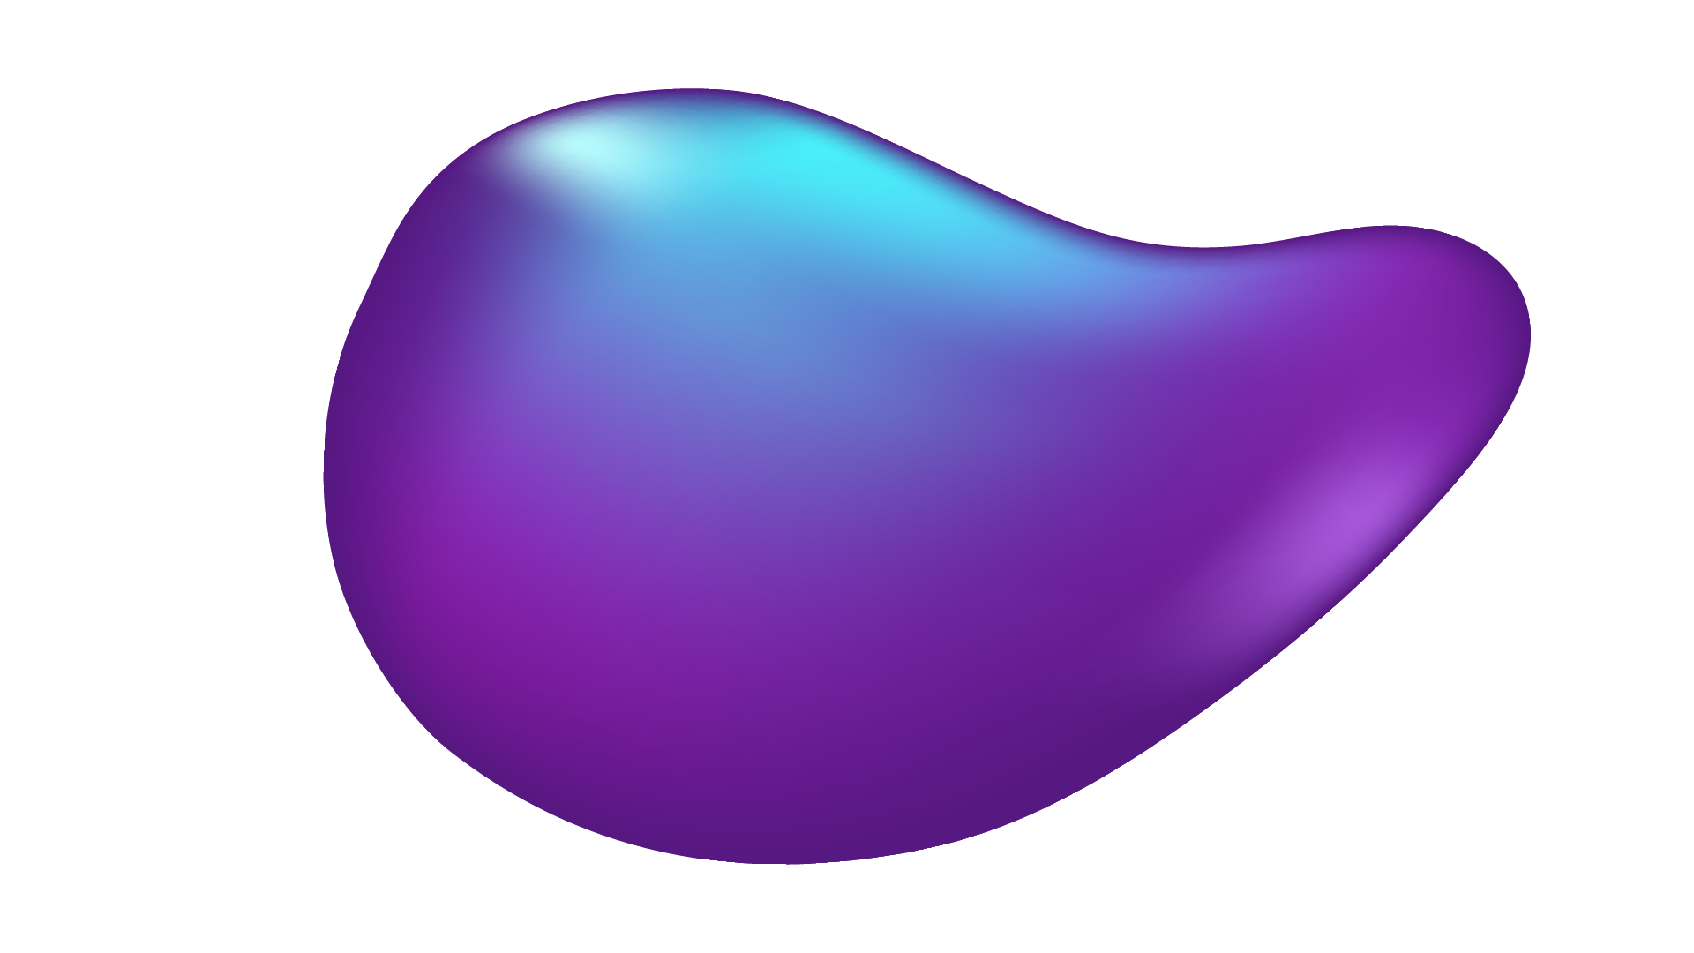

Face Recognition Attendance System

Slide 2
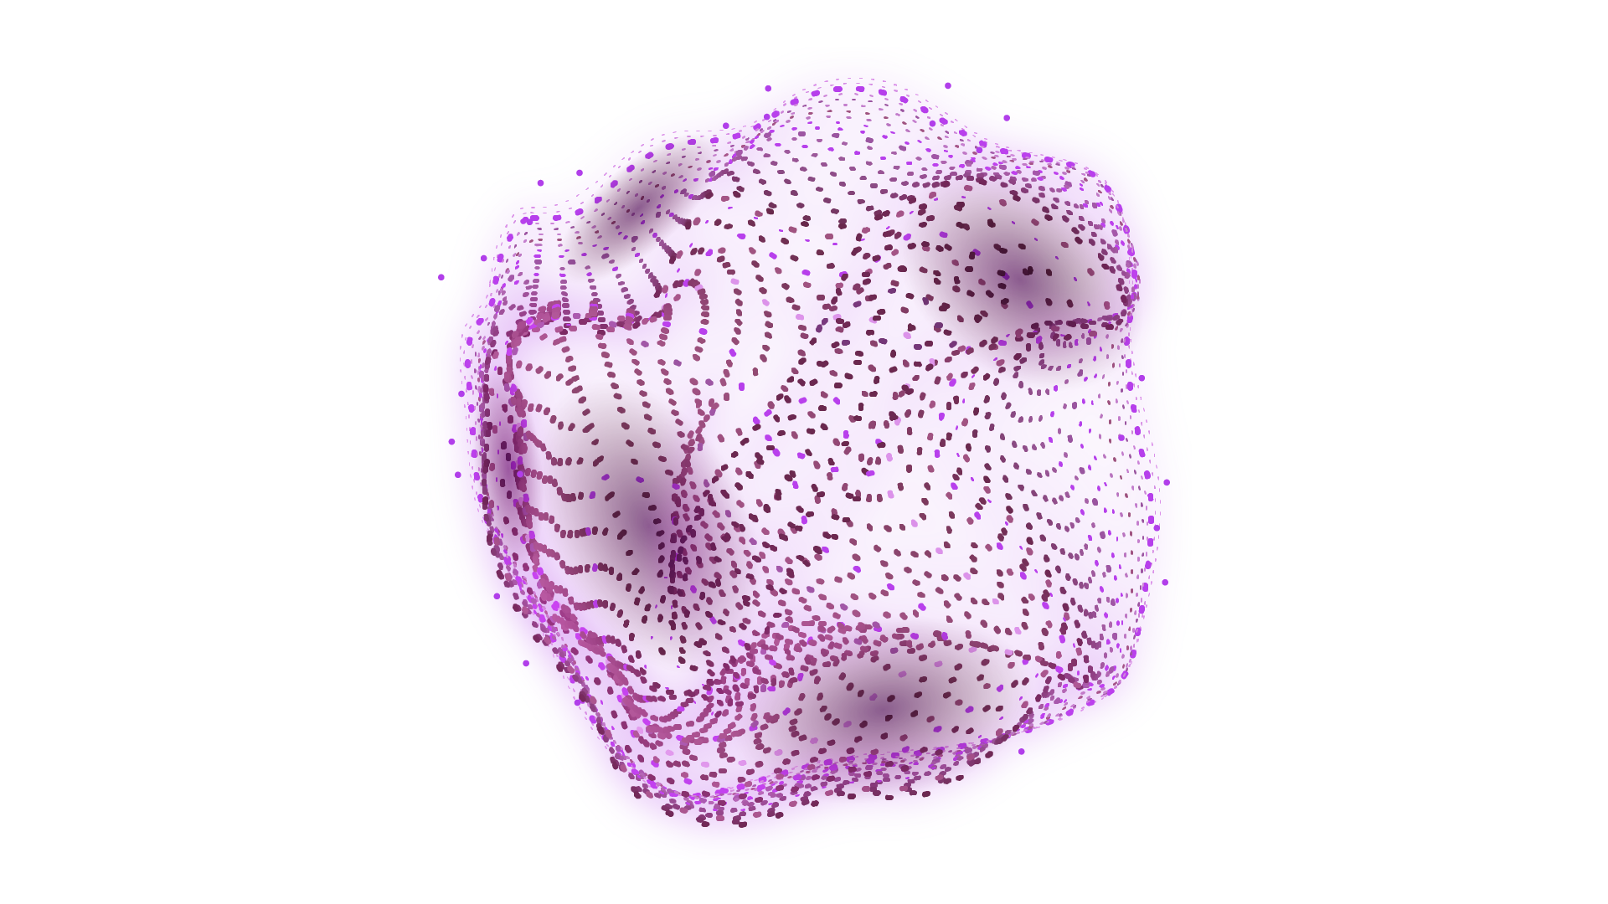
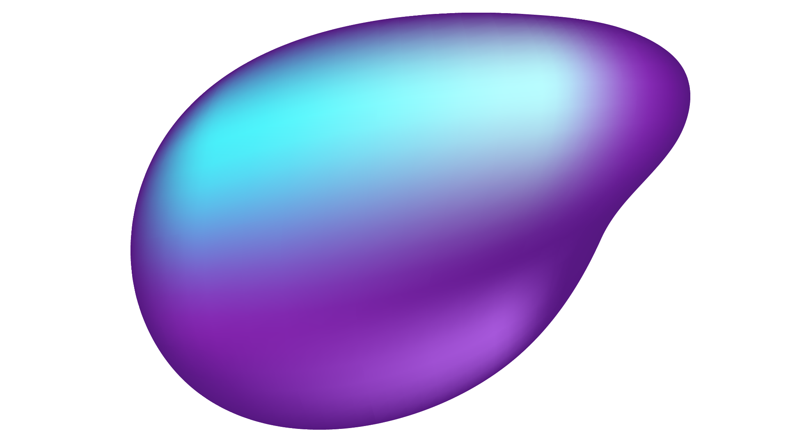
OUR TEAM
Mohamed Amr Ahmed Madkour
Mohamed Salah El-Din Abdel-Qader
Mohamed Abdel-Baky El-Sayed Bakry
Omar Mohamed El-Sayed El-Tony
Mariam Ahmed Abdel El-Hady Salman
Weam Osama Mohamed Kassem
OUR SUPERVISORS
Dr/ Sahar Kamal
Eng/ Amira El-Sayed

Slide 3
POINTS TO BE DISCUSSED
01
02
03
04
05
ABOUT THE PROJECT
FACE DETECTION
FACE RECOGNITION
BACK-END IMPLEMENTATION
USER INTERFACE DEVELOPMENT

Slide 4

01
ABOUT THE PROJECT

Slide 5
INTRODUCTION
In today’s academic environments, ensuring accurate and efficient attendance tracking is both a logistical and administrative challenge. Traditional manual methods are not only time-consuming but also prone to errors and misuse, such as proxy attendance.
To address these issues, our project proposes a real-time intelligent attendance system that leverages advanced computer vision and deep learning technologies. The system combines YOLOv11 for fast and robust face detection with FaceNet for high-accuracy facial recognition.

Slide 6
PROBLEM STATEMENT
Manual attendance is slow, inaccurate, and prone to proxy entries.
There’s a growing need for smart, automated solutions in educational institutions.

Slide 7

WHAT ARE WE WORKING ON?
TRAIN
DEPLOY
DEVELOP
An AI model for Face Detection & Recognition
A Database System for records storage and data integrity assurance
A user interface to be able to interact with the system

Slide 8
02
FACE DETECTION
Using YOLOv11n

Slide 9
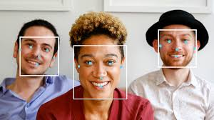
Face detection overview
Identifies and locates human faces in images/videos.
First step in facial recognition systems.
Analyzes facial features like eyes, nose, mouth.
Used in smartphones, surveillance, social media.
Powered by machine learning & deep learning for high accuracy.

Slide 10

Face detection algorithm(YOLO)
Using the newest version of YOLO (YOLOv11 )for Face Detection:
Yolo11 is the fastest and most accurate deep learning model.
Divides image into grids to detect face locations.
Works in real-time.
Trained on face datasets.

Slide 11
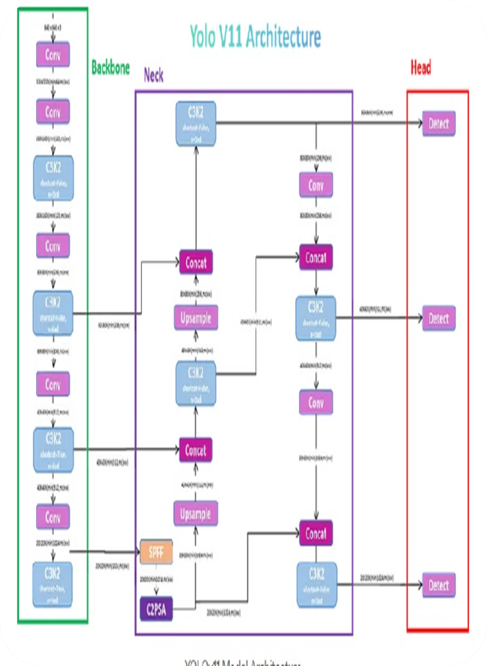
Face detection algorithm(YOLO)
Implemented face detection using YOLOv11.
Model architecture included:
C3K2 (Backbone): Main feature extraction component.
SPPF (Neck): Enhances the extracted features.
C2PSA (Head): Responsible for predictions.
Initial training showed promising results but needed improvement.

Slide 12
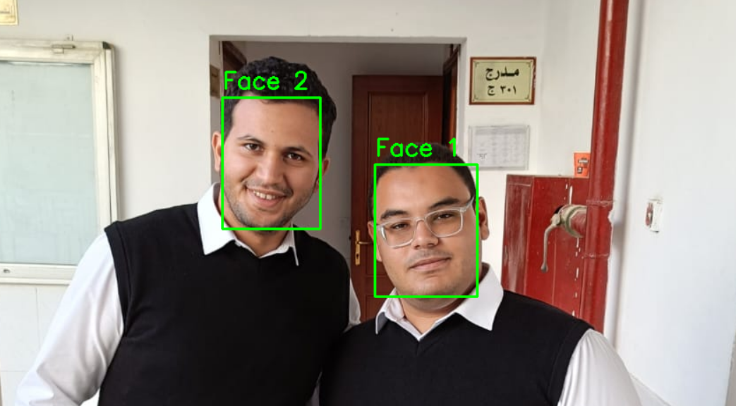
Face detection algorithm(YOLO)
Retrained YOLOv11 with a larger and more diverse dataset.
Achieved better accuracy and reduced false detections.
Detection is now more stable and ready for the face recognition phase.

Slide 13



Detection Performance
94%
92%
81%
EASY
MEDIUM
HARD

Slide 14
03
FACE RECOGNITION
Using FaceNet With InceptionResNetV1

Slide 15
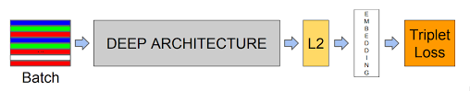
FaceNet with InceptionResNetV1
FaceNet is a face recognition framework that maps face images to a compact embedding space, where distances between embeddings reflect facial similarity.
It uses InceptionResNetV1 as its backbone to extract these embeddings.

Slide 16
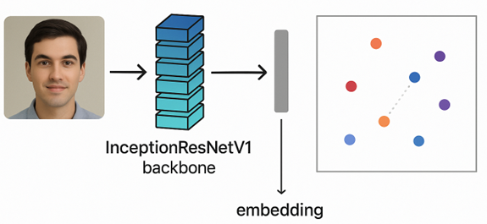
InceptionResNetV1 Architecture
Backbone: InceptionResNetV1 combines Inception modules (parallel convolutional layers with different filter sizes) and residual connections (inspired by ResNet) for deeper, more robust feature extraction.

Slide 17
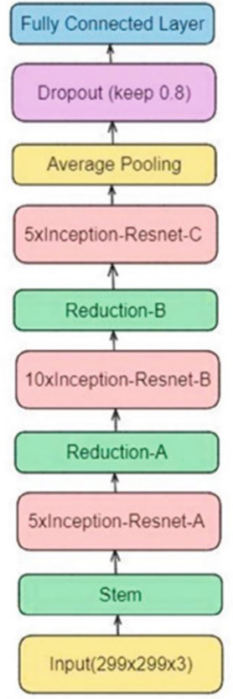
InceptionResNetV1 Architecture(Cont.)
Inception Blocks: Capture multi-scale features by applying 1x1, 3x3, and 5x5 convolutions in parallel.
Stem : It performs basic feature extraction and reduces spatial dimensions.
Residual Connections: Add shortcut connections to ease gradient flow and enable deeper networks.

Slide 18
InceptionResNetV1 Architecture(Cont.)
Fully Connected Layer: Maps the final feature map to the embedding vector.
L2 Normalization: Ensures embeddings lie on a unit hypersphere for consistent distance comparisons.

Slide 19
Full pipeline of Face Detection & Recognition
Dataset Collection
Face Detection
Image Preprocessing
Face Recognition
Face Embedding
Test the System

Slide 20
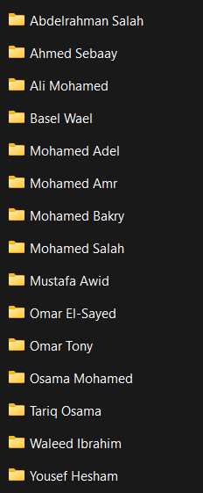
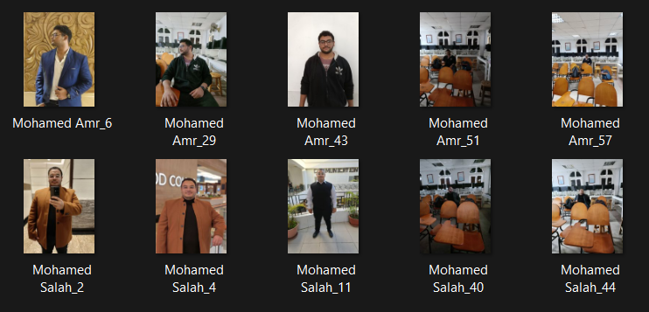
STEP 1 : Dataset Collection
Collect about 20-30 images for each student

Slide 21
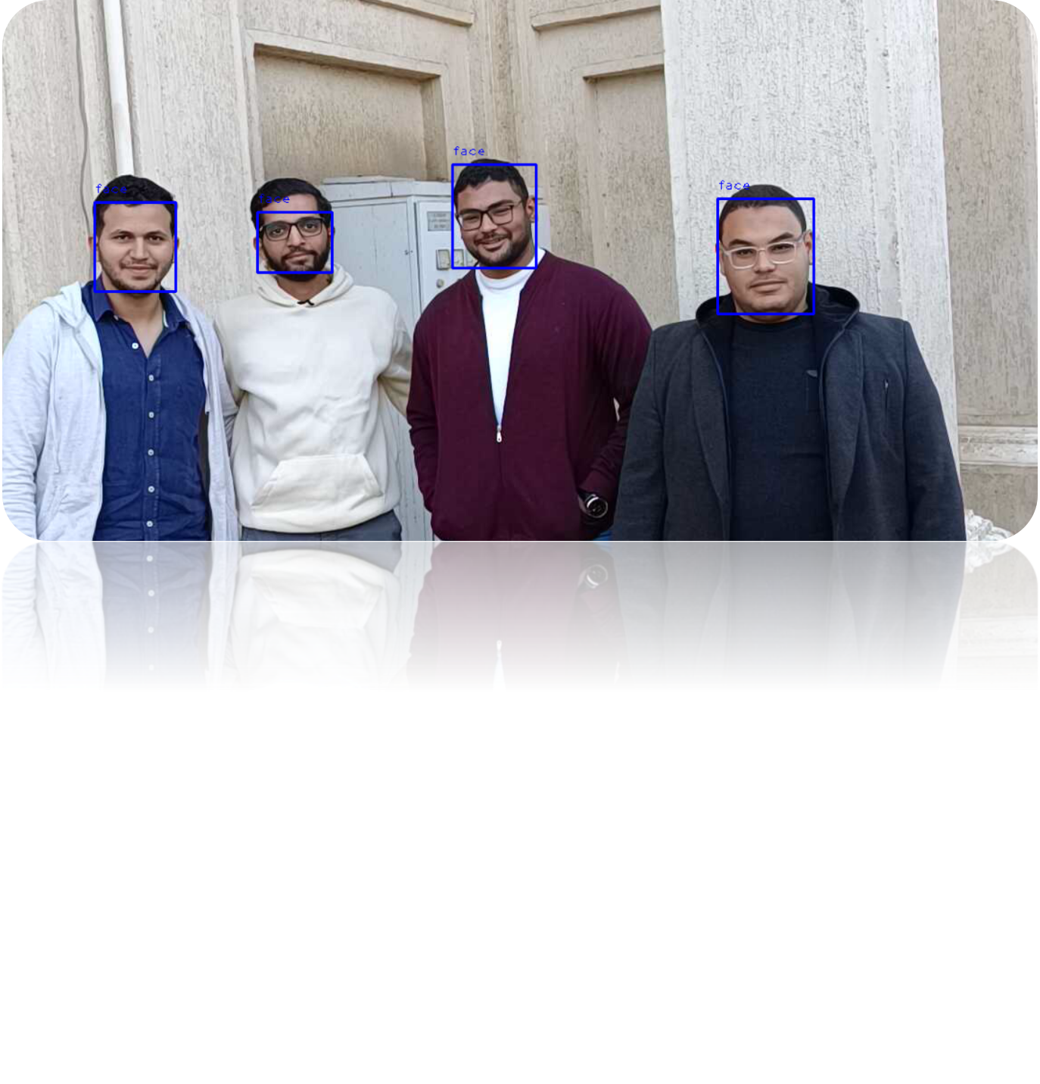
STEP 2 : Face Detection
Detect Faces using YOLOv11n from video stream or image

Slide 22
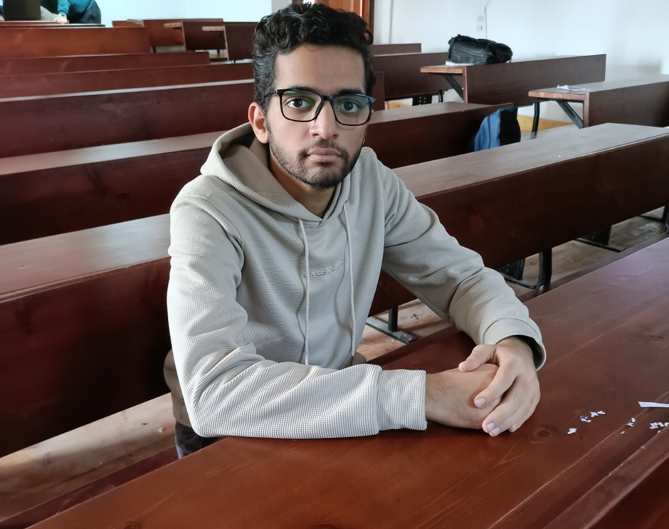
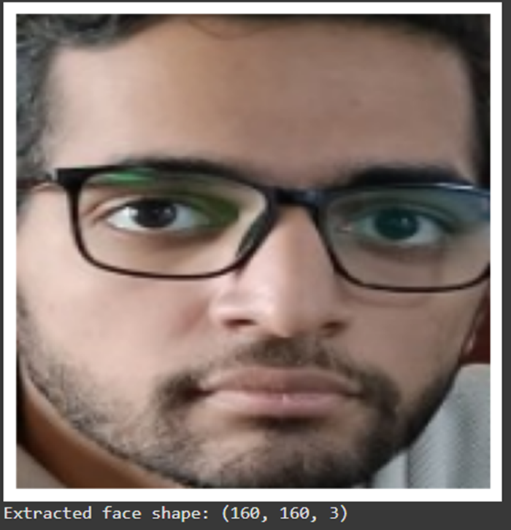
STEP 3 : Image Preprocessing
FaceNet expects all faces to be:
Aligned
Resized to (160×160) pixels
Normalized

Slide 23
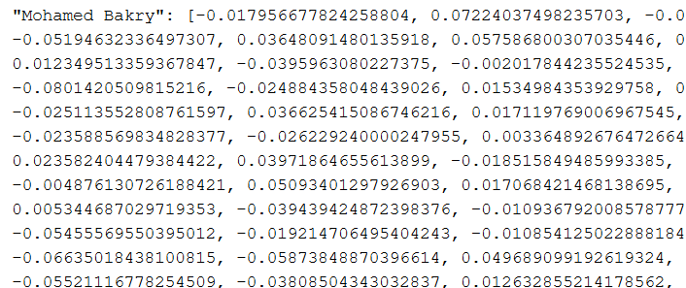
STEP 4 : Face Embedding
FaceNet is a deep neural network trained to map each face to a 128-dimensional vector (embedding) Similar faces will have similar vectors (Euclidean distance)

Slide 24
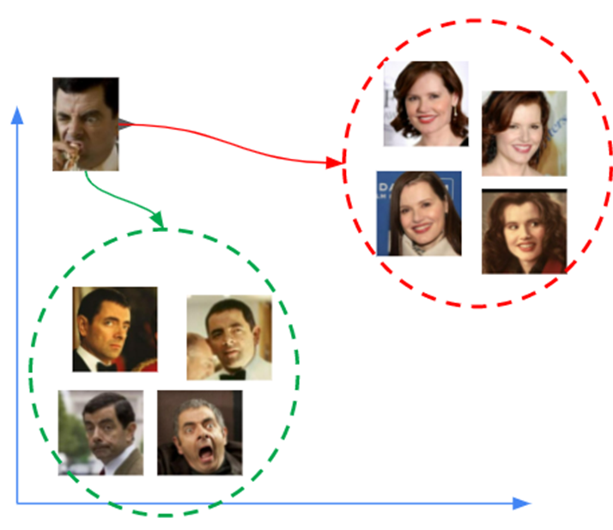
STEP 5 : Face Recognition
Distance threshold :
Compare live embedding to all stored embeddings
Use Euclidean distance
If distance < threshold, it is a match

Slide 25
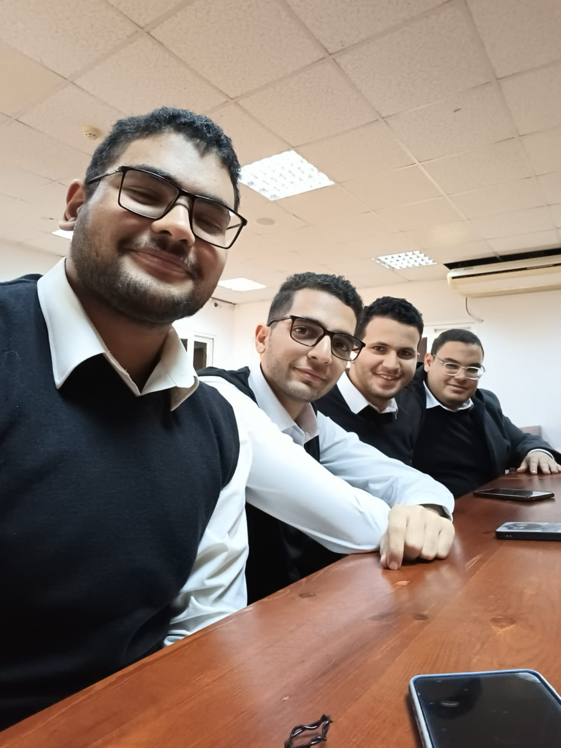
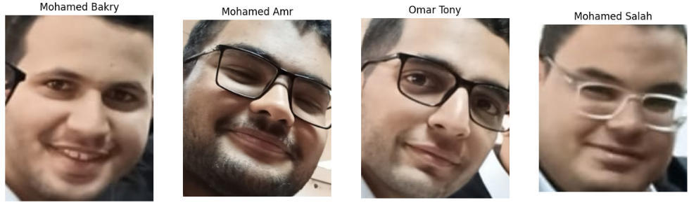
STEP 6 : System Testing
Input
Output

Slide 26
Limitations
LIGHT
FACE ANGLE
Performance may vary in extreme lighting conditions
Best suited for frontal and slightly angled faces
RESOLUTION
Optimal performance for faces occupying >20 pixels

Slide 27
04
BACK-END IMPLEMENTATION

Slide 28
Back-end Structure
I : Back-end Business Logic
II : Database Structure
III : Back-end Features

Slide 29
I : Back-end Business Logic (What Should happen ?)
1- Student Registration & Data Management :
students are stored in "students" table.
personal data : name, ID, contact info, photo , enrollment info.
On registration --> facial embedding is generated and stored linked via student_id.

Slide 30
I : Back-end Business Logic (Cont.) (What Should happen ?)
2- Attendance Tracking :
Detection : Camera : YOLO detects faces in classroom
Recognition : Detected faces are compared with embeddings stored for each student
Marking Attendance : If a match is found, a new record is inserted into the attendance table with :
student_id
timestamp
Status (eq. present)
course_id & session_id

Slide 31
I : Back-end Business Logic (Cont.) (What Should happen ?)
3- Course & Schedule Management
Courses are in "courses" table.
sessions define when each course occur (linked to timetable).
Backend checks session time to validate when attendance can be marked.

Slide 32
I : Back-end Business Logic (Cont.) (What Should happen ?)
4- Leave & Excuses Management
Students can request to leave via “leave_requests” table including :
student_id
Reason
Date range
Status (Pending, Approval)

Slide 33
I : Back-end Business Logic (Cont.) (What Should happen ?)
5- Reporting & Dashboard
Queries aggregate data per student, per course & per session.
Back-end provides endpoints to retrieve :
Number of excused absence
Weekly or Monthly summaries

Slide 34
II : Database Structure
I : ERD

Slide 35
III : Back-end Features
1- Real-Time attendance marking through recognition :
When a student enters the classroom, their face is captured and sent to a facial recognition module that compares it to stored embeddings in the database. If a match is confirmed, the system marks them as ‘Present’ in the attendance table instantly — all without manual intervention.”

Slide 36
III : Back-end Features
2. Robust Data Validation (Only During Active Sessions)
To prevent false attendance marking, the backend checks whether a course session is currently active before recording attendance. This ensures that students cannot be marked as present outside their scheduled class times.
Features Included :
Search/filter by student, course, date range
View attendance percentage
See absences, leaves, and trends over time
Export data (CSV, PDF, etc.)

Slide 37
III : Back-end Features
3. Admin Dashboard to Manage and View Student Progress
We’ve built an admin interface where authorized users can view student attendance records, generate reports, manage course schedules, and review leave requests — all from a central dashboard.

Slide 38
III : Back-end Features
4. Integrated Leave Requests (Don’t Count Against Attendance)
Students can request leave through the system. When approved, those dates are excluded from absence calculations, ensuring fairness.
Logic:
Leave dates are stored in the “leave_requests” table.
When calculating attendance percentage:
Total expected sessions – approved leaves = net sessions

Slide 39
Back-end Features (Summary)
Real-Time Attendance | Face detected & matched via YOLO + embeddings.
Validated Timing | Attendance allowed only during active sessions.
Admin Dashboard | Visualize reports, manage students & schedules.
Leave Integration | Approved leaves don’t affect attendance score.

Slide 40
05
USER INTERFACE DEVELOPMENT

Slide 41
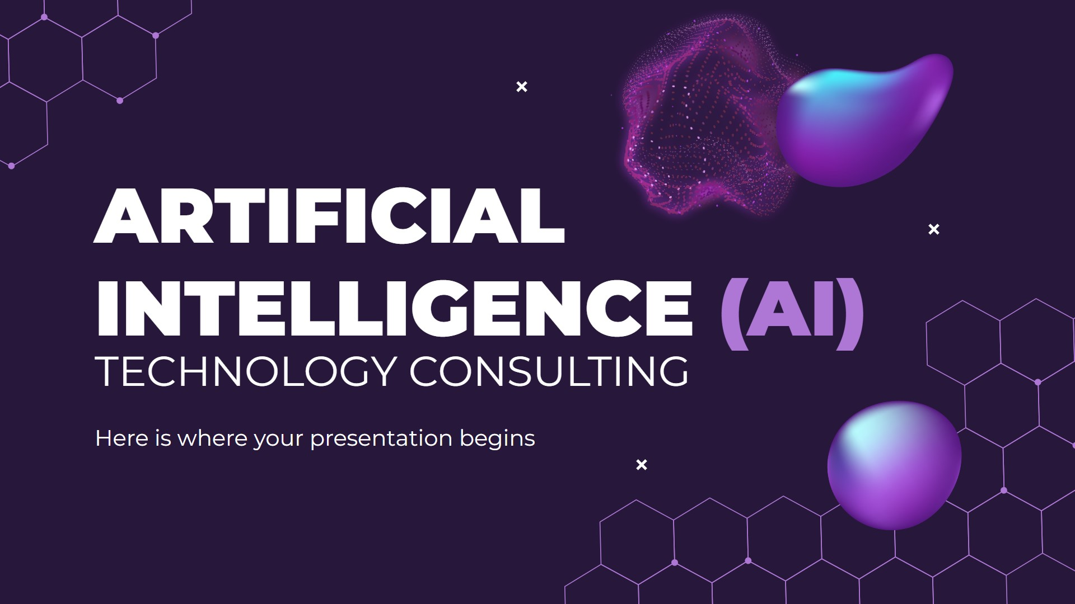
MOBILE and WEB INTERFACE

Slide 42
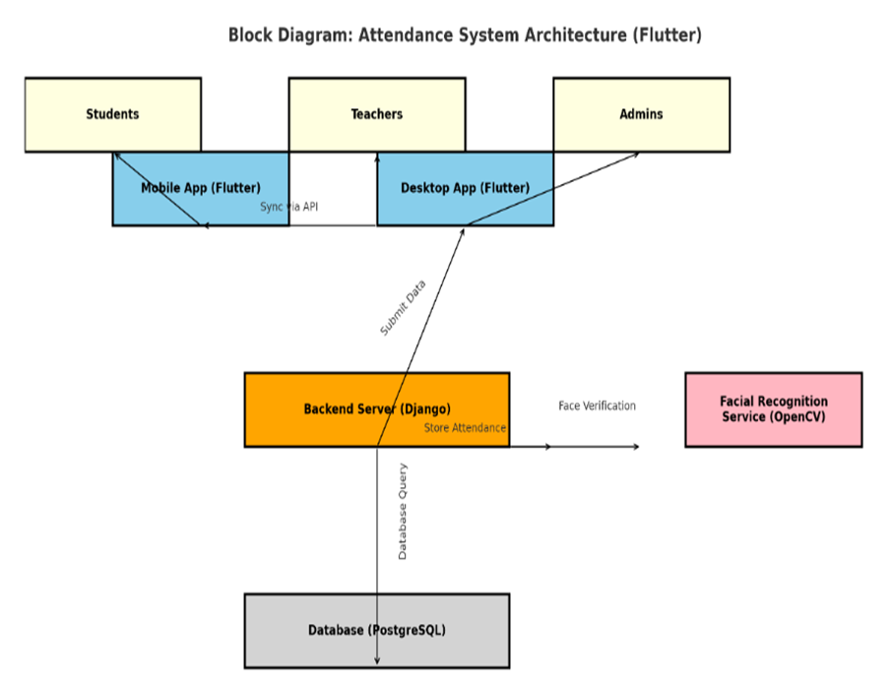
Application System (Context Diagram)
Defined system roles and structure.
Designed system architecture connecting Mobile App, Web Dashboard, API, AI Model, and Database.
Prepared environment for development.

Slide 43
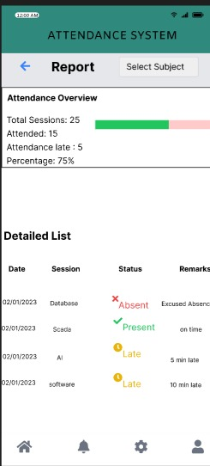
Business Process
Mobile App (Student):
Student logs in using mobile app.
If absent, submits leave request.
Views updated attendance reports.

Slide 44
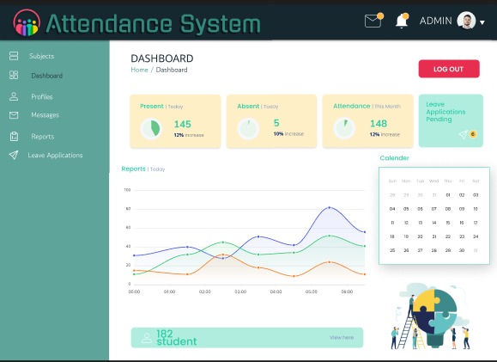
Business Process
Web Dashboard(Supervisor):
Teacher logs in through web dashboard.
Reviews attendance records and reports.
Approves or rejects leave requests.
Views student profiles and performance.

Slide 45
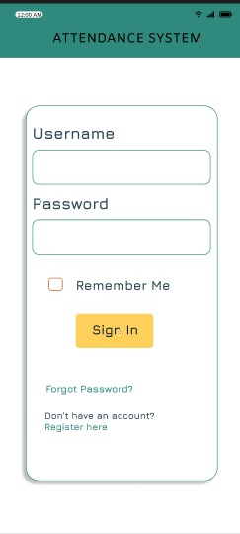
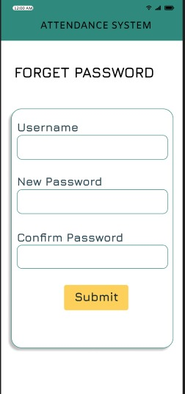
Requirements (Mobile Application)
1- Functional Requirement :
Login Page
Registration Page
Forgot Password Page
Attendance Record
Reports
Notifications
Profile Page
Request Absence Page
Settings Page

Slide 46
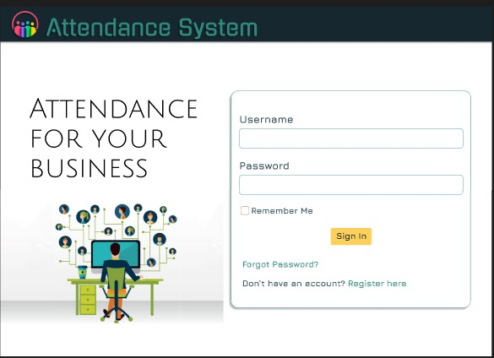
Requirements (Web Dashboard)
1- Functional Requirement :
Login Page
Forgot Password Page
Dashboard Page
Profile Page
Student Details Page
Subjects Page
Monthly Reports
Messages
Exit Application

Slide 47
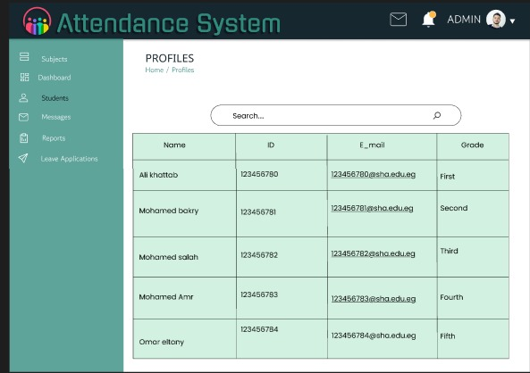
Requirements
2- Non-Functional Requirement :
Usability
Availability
Maintainability
Performance

Slide 48
Business Rules
These rules are represented and explained using:
Mobile Application
Activity Diagram
Use Case Diagram
Class Diagram
Web Dashboard
Activity Diagram
Use Case Diagram
Class Diagram

Slide 49
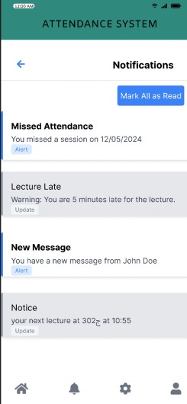
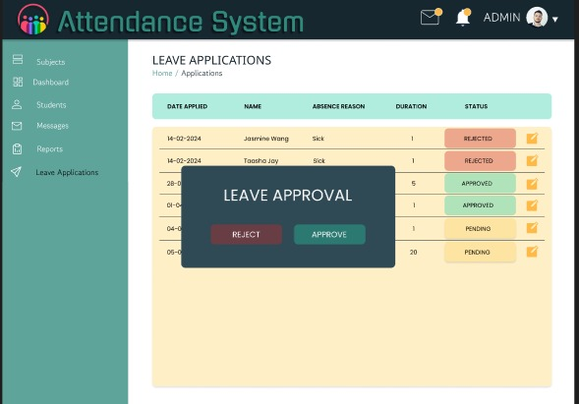
Figma Design

Slide 50
Implementation Mobile Application
Structured with three main folders:
Built core screens: Home, Profile, Report, Absence, Notifications
Integrated bottom navigation and reusable widgets
Pages
Models
widgets

Slide 51
Implementation Web Dashboard
Web System (Django + HTML):
Developed HTML templates: Dashboard, Absence Requests, Reports, Profile
Handled routing and business logic with Django Views
Role-based access implemented (instructor)
Connected each HTML page with its own view function in views.py
Registered each page path in urls.py using path() and name

Slide 52
CONCLUSION
This system combines YOLOv11 for face detection and FaceNet for face recognition to create an accurate, real-time attendance solution. It uses an IP camera to detect and identify students, logs attendance automatically to a secure database, and provides a mobile app for students and a web dashboard for teachers—making the entire process efficient, reliable, and user-friendly.

Slide 53
THANK YOU

